Slide 2
BIOMETRICs
Presented by
JOSEPH GEORGE
Roll no:38
S2 B batch

Slide 3
CONTENTS
Introduction to biometric
Types of biometric
Finger scanner
Face scanner
Hand scanner
Iris or retina scanner
Advantage of biometric
Disadvantage of biometric
conclusion

Slide 4
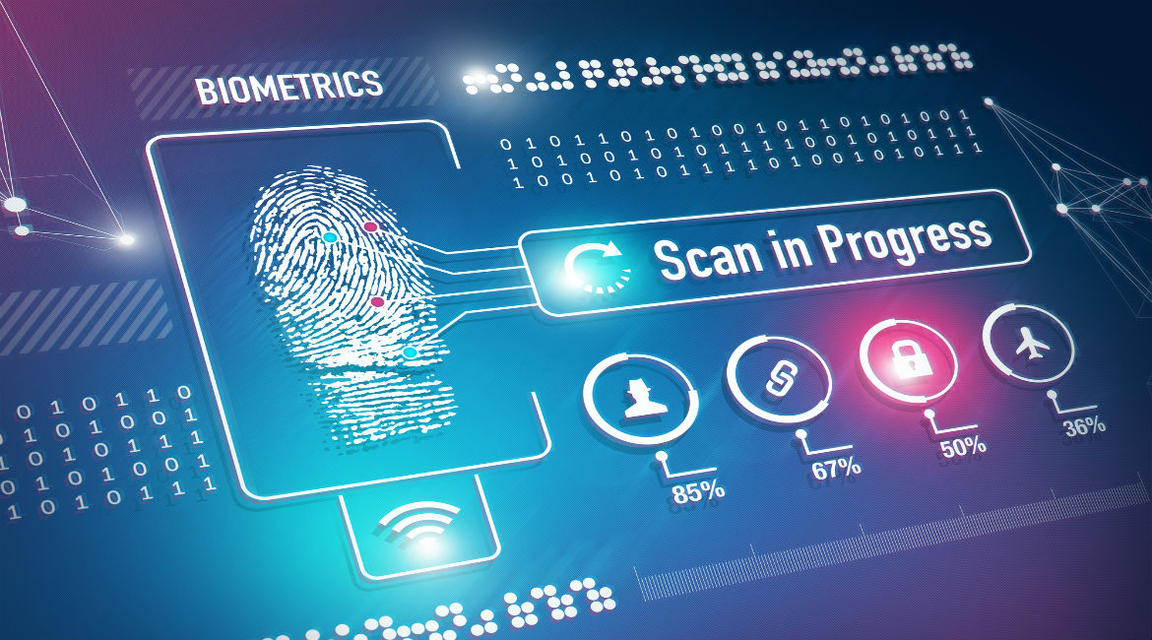
WHAT IS BIOMETRICS
Biometrics refers to an automatic identification of a person by their biological features.
For example, users identifying themselves to a computer or building by their fingerprint or voice is considered a biometrics identification.
The term biometrics also refers to all processes used to recognize, authenticate and identify persons based on certain physical or behavioral characteristics.

Slide 5
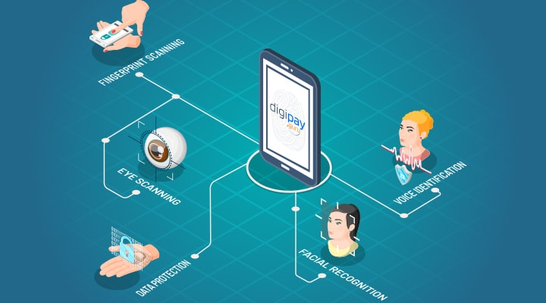
Compared to a password, this type of system is much more difficult to fake, since it is unique to the person.
Other common methods of a biometrics scan are a person's face, hand, iris, and retina.
As an emerging technology, biometric system can add great convenience by replacing password.

Slide 6
TYPES OF BIOMETRIC DEVICES :
Face scanner
Hand scanner
Retina scanner or iris scanner
Finger scanner

Slide 7
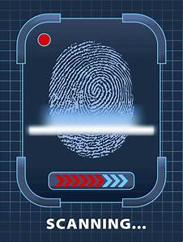
FINGER SCANNER
It is the oldest form of biometric.
Each person has his or her own unique fingerprints – even identical twins have different fingerprints. A fingerprint comprises about a hundred major features, called minutiae. In most cases, a match between around a dozen minutiae is needed to prove that two fingerprints are identical, and establish a person’s identity to a very high degree of certainty.

Slide 8
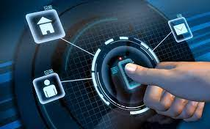
Fingerprints are unique in nature .Everyone is born with one.
Fingerprint pattern stable through out the life.
The recovery of partial fingerprint from a crime scene is an important method of forensic science

Slide 9
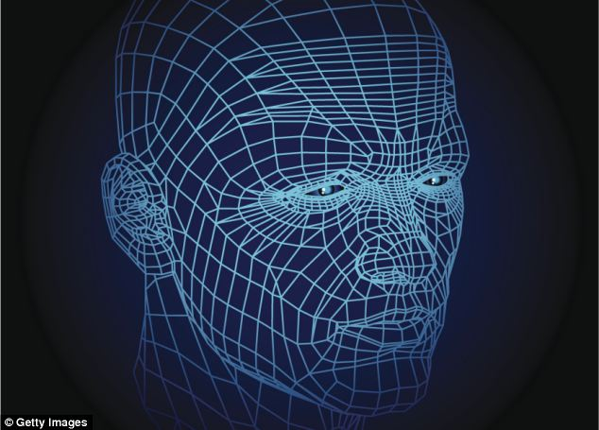
FACE SCANNER
Facial recognition software is capable of identifying an individual according to their facial morphology.
Its effectiveness depends on several key factors, including the quality of the captured image, the power of the identification algorithms as well as the reliability of the databases used (the larger the database, the greater the probability of identifying a person), etc.
These scanners can be very secure, assuming they're smart enough to distinguish between a picture of a person and a real person.

Slide 10
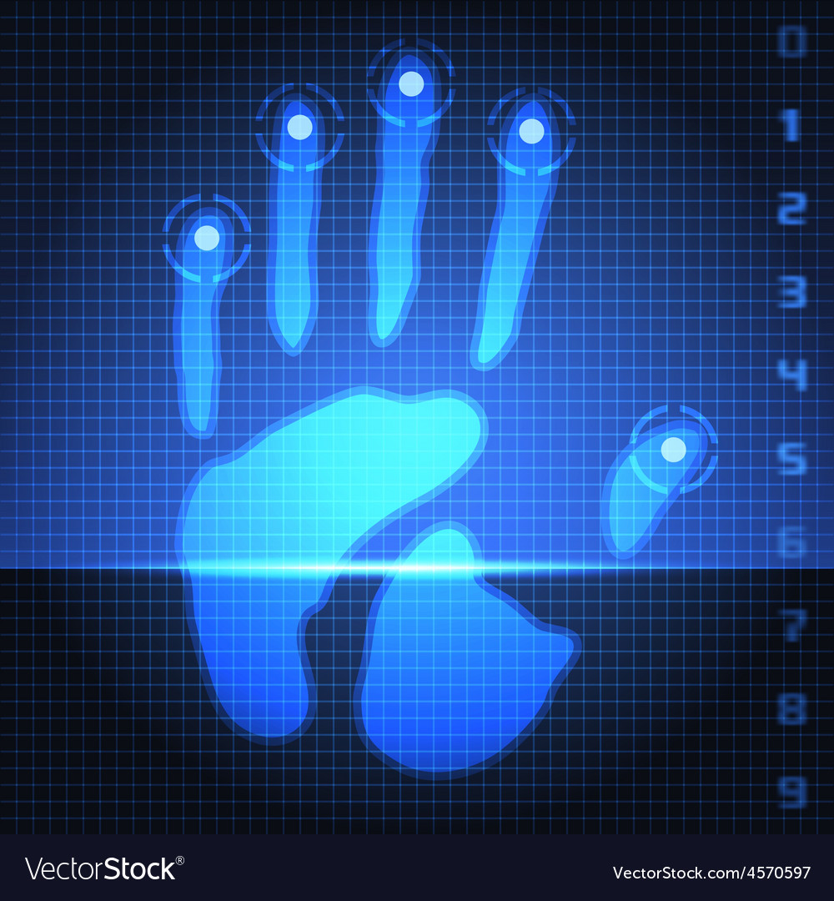
HAND SCANNER
Hand scanner - Like your fingerprint, the palm of your hand is also unique to you.
A biometric hand scanner will identify the person by the palm of their hand.
Hand scanner is an automated measurement of many dimensions of the hand and fingers.
The first modern biometric device was hand geometry reader that measured finger length.

Slide 11
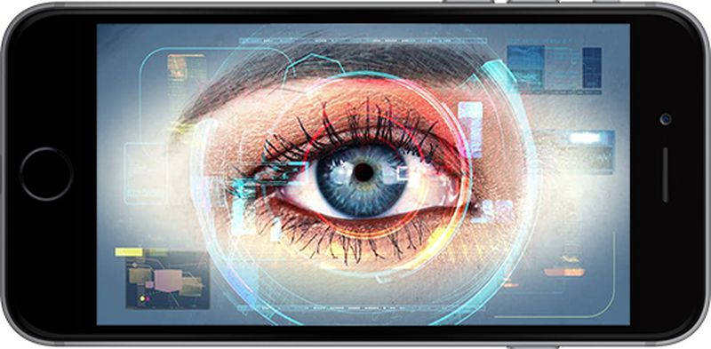
RETINA SCANNER AND IRIS SCANNER
Retina scanner or iris scanner - A biometric retina or iris scanner identifies a person by scanning the iris or retina of their eyes.
These scanners are a more secure biometric authentication schemes
because there's no known way to duplicate the retina or iris.
Iris scanning measures the iris pattern in the colored part of the eye.
There are 240 features that make every individual’s iris unique

Slide 12
Advantage of Biometrics 1. Better Security 2. Accuracy 3. Save Time 4. Trustable 5. No forgotten password

Slide 13
DISADVANTAGE
Biometrics device are expensive.
The finger print of those people working in chemical industries are often affected.
Scanning of eye is fearful to some people.
It is found that with age, the voice of a person differs.

Slide 14
CONCULSION
Biometrics is a very interesting and exciting field that has be growing exponentially in recent year.
Biometric system provide high degree of confidence in user identity.
While biometric authentication can offer a high degree of security, they are far from perfect solution
Let us hope for safe and secure future.

Slide 15
THANK YOU……

